Slide 1

Machine Learning project on FIFA 2018 Statistics
Term 2 – Project
By – Diwjen Philixon(diwjenp@gmail.com

Slide 2
1. Introduction.
2. Problem Statement.
3. Exploratory Data Analysis
4. Training and Classification
5. Conclusion
AGENDA

Slide 3
1. Introduction
In the Exploratory Data Analysis we are using Python skills on a structured data set including loading, inspecting, wrangling, exploring, and drawing conclusions from data.
The notebook has observations with each step in order to explain thoroughly how to approach the data set.
Machine Learning algorithms are used to predict the Man of the Match.

Slide 4
2. Problem Statement
Aim is to Predict the Man of Match in the tournament by using Machine Learning algorithms.

Slide 5
3. Exploratory Data Analysis
Is there any relationship between First goal time & Man of match?
Detection of outliers and its influence on MoM ?
Understanding how statistics of one feature is impacted in presence of other features ?
How many patients survived.

Slide 6

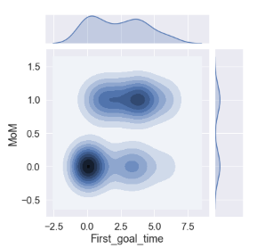
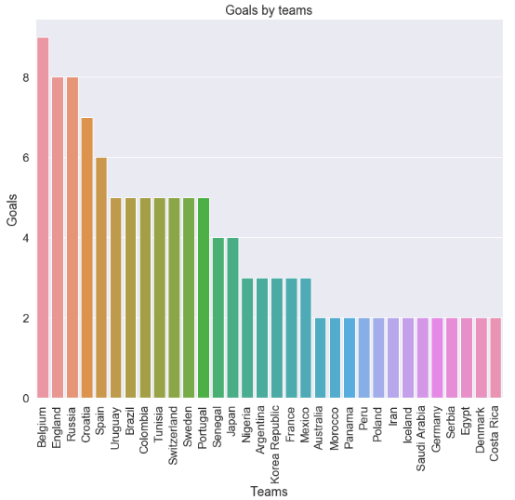
Is there any relationship between First goal time & Man of match?
From the joint plot between First Goal Time & MoM we see a high co relation.
We also see highest number of Goals are scored by Belgium.

Slide 7
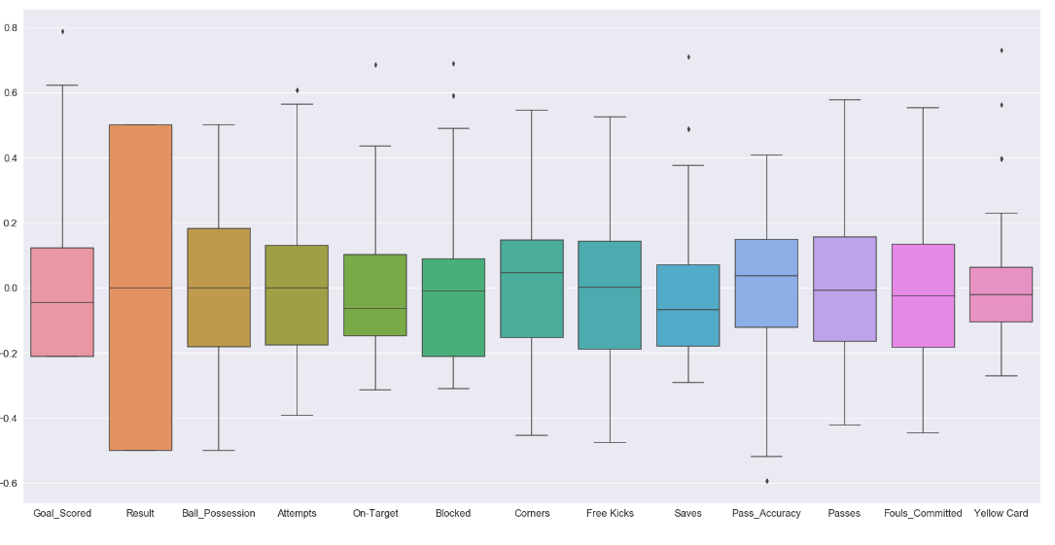
Detection of outliers and its influence on MoM ?
In statistics, an outlier is an observation point that is distant from other observations. An outlier may be due to variability in the measurement or it may indicate experimental error; the latter are sometimes excluded from the data set.
In simple words, for a normally distributed data any value that lies beyond range of 1.5 times IQR (Inter quartile range) is considered to be an outliers.
However, 'outliers = anything > 1.5*IQR' does not word practically, as real data are not normally distributed.
Pragmatic approach: plot scatter visualization or boxplot and identify abnormally distant points
The quantity of outliers present in this problem is not too huge and will not have gravity impact if left untreated. They are only few and within range.

Slide 8
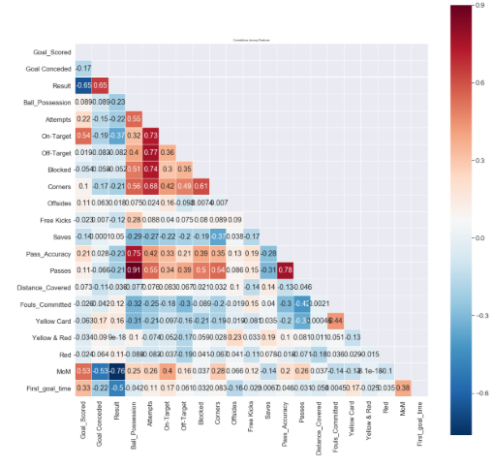
Understanding how statistics of one feature is impacted in presence of other features .
Man of the Match' is highly correlated with 'Goal Scored', 'On-Target', 'Corners', 'Attempts', 'free Kicks', 'Yellow Card', 'red', 'Fouls.
Committed', 'Own goal Time’
Own goal time is twins of 'Ball possession %', and Passes, pass Accuracy
Pass HCW Pass Accuracy %.
These features have least or no correlation with 'Man of the Match'
['Blocked', 'OffSides', 'Saves','Distance Covered (Kms)', 'Yellow & Red', '1st Goal', 'Goals in PSO']
These features will not have impact on aur analysis and thus, holding them or retaining them is our choice

Slide 9
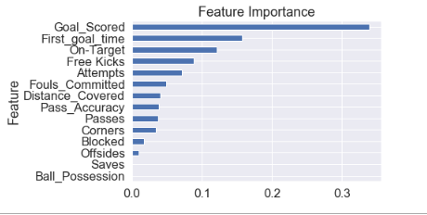
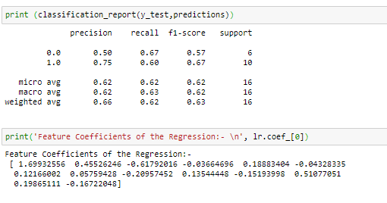
4. Training and Classification
Random Forest
Decision Tree
Best mean CV accuracy: 0.875
Testing set Score: 93.75%
Logistic Regression
Test accuracy: 0.625
Best mean CV accuracy: 0.875
Holdout test set accuracy: 0.75
Best parameters: {'criterion': 'entropy', 'max_depth': 2, 'n_estimators': 15, 'random_state': 69}
The random forest performed the best (looking at cross validation error)!

Slide 10

5. Conclusion
Decision Tree had the best performance with a accuracy score.
It allowed us to understand that the winner of the match is the most important predictor of the Man of the Match, followed by the number of goals scored.
It should be noted that the random forest didn't generalize well to the final test set, scoring only 62.5%. Other features may need to be mined from the data to correct for this.
We obtain 62.5% accuracy using Logistic Regression Model.

Slide 11
Thank You

